Slide 1

MVC Framework

Slide 2
Topics
Layout/ViewStart
Area
Passing Data between controls/View
Html Helper

Slide 3
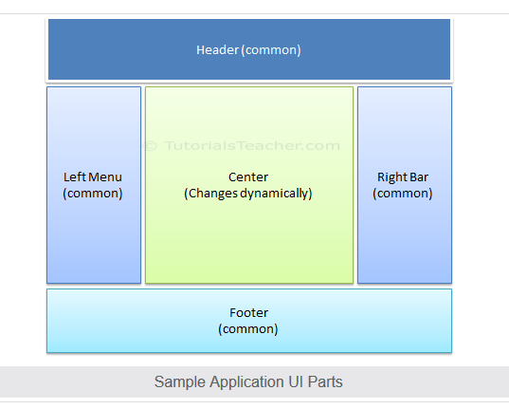
Layout View:
What is Layout view?
An application may contain common parts in the UI which remains the same throughout the application such as the logo, header, left navigation bar, right bar or footer section. ASP.NET MVC introduced a Layout view which contains these common UI parts, so that we don't have to write the same code in every page. The layout view is same as the master page of the ASP.NET web form application.

Slide 4
Viewstart Page in ASP.NET MVC
The _ViewStart.cshtml page is a special view page containing the statement declaration to include the Layout page.
Instead of declaring the Layout page in every view page, we can use the _ViewStart page.
When a View Page Start is running, the “_ViewStart.cshtml” page will assign the Layout page for it.

Slide 5
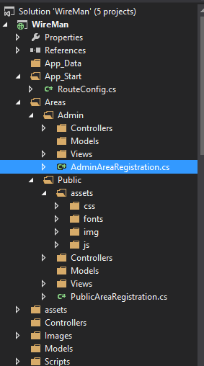
Area in MVC
Areas are logical grouping of Controller, Models and Views and other related folders for a module in MVC applications.
Using areas, we can write more maintainable code for an application cleanly separated according to the modules.

Slide 6
Registering Area Routes
When you add an area to a project, a route for the area is defined in an Area Registration file. The route sends requests to the area based on the request URL.
Insert the following code into the Application Start method:
AreaRegistration.RegisterAllAreas();

Slide 7
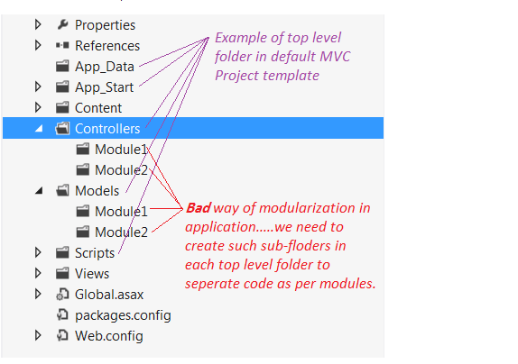
Debate on Alternate Approach
The nature of functionality of modules may be different (there would be less scope of shared code) and you may need to categorize CSS, scripts, models and other related functionalities for modules too.
There may be name conflict for controller if modules need to have the controllers with same name
The code of specific module will be more scattered

Slide 8
Passing Data in MVC
Viewbag
ViewData
TempData

Slide 9
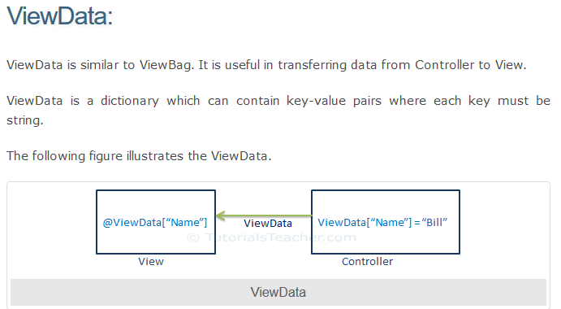

Slide 10
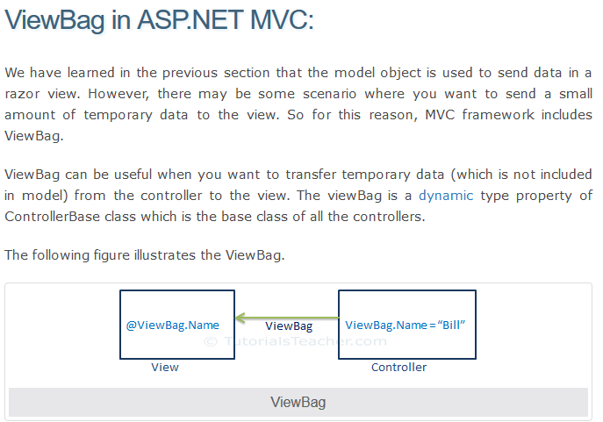

Slide 11
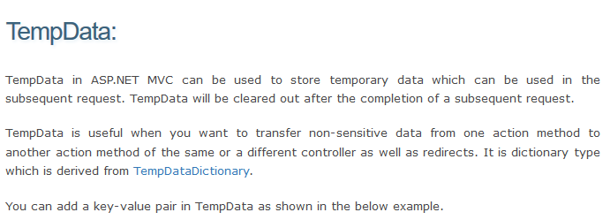

Slide 12
HTML Helpers
An HTML Helper is just a method that returns a HTML string. The string can represent any type of content that you want. For example, you can use HTML Helpers to render standard HTML tags like HTML <input>, <button> and <img> tags etc.

Slide 13
The following is the list of Html Helper controls.
Html.Beginform
Html.EndForm
Html.Label
Html.TextBox
Html.TextArea
Html.Password
Html.DropDownList
Html.CheckBox
Html.RedioButton
Html.ListBox
Html.Hidden
Example
@Html.Label("Enter your name")

Slide 14
Below are Strongly Type Html Helper methods, this will allow us to check compile time errors. We get Model's Property intelligence at Runtime.
Html.LabelFor
Html.TextBoxFor
Html.TextAreaFor
Html.DropDownListFor
Html.CheckBoxFor
Html.RadioButtonFor
Html.ListBoxFor
Html.HiddenFor
Example
@Html.TextBoxFor(m => m.FirstName, new { @class = "form-control", @placeholder = "Enter First Name" })

